Slide 1
Lecture-10
Fourier Transform

Slide 2
Objective:
Discuss how Fourier transform is a generalization of Fourier series
Discuss the conversion of time domain data into frequency domain using mathematical formulae
How to find Fourier transform of a function

Slide 3
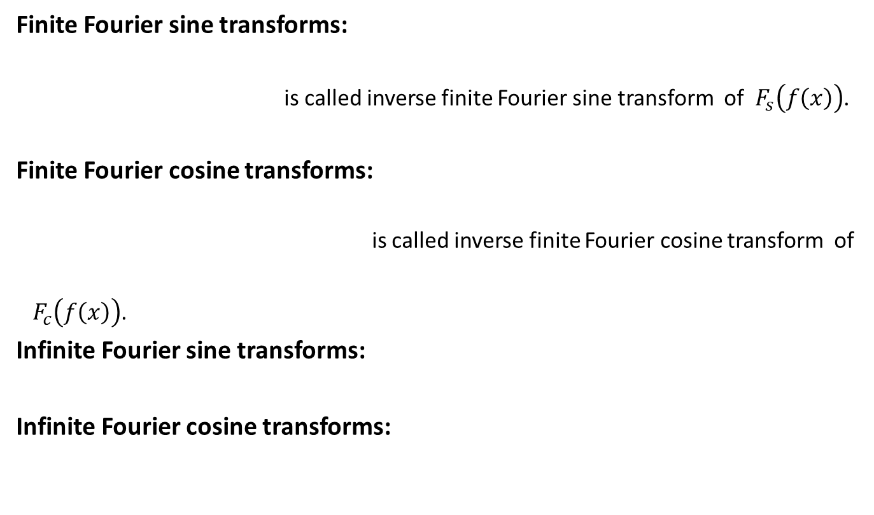
Fourier Transform (Formulae)
Finite Fourier sine transforms:
is called inverse finite Fourier sine transform of $F_{s}\left(f\left(x\right)\right)$.
Finite Fourier cosine transforms:
is called inverse finite Fourier cosine transform of
${ F}_{c}\left(f\left(x\right)\right)$.
Infinite Fourier sine transforms:
Infinite Fourier cosine transforms:

Slide 4

Solved Problems
Example: Find the Fourier sine transform of
Here $L=π$
We know the finite Fourier sine transforms of $f(x)$ is
.

Slide 5
Solved Problems
Example: Find the Fourier cosine transform of
.

Slide 6
Solved Problems (Continued)
Example:
Find the Fourier sine transform of
Infinite Fourier sine transform

Slide 7
Solved Problems (Continued)
Example:
Find the Fourier cosine transform of
Infinite Fourier cosine transform

Slide 8
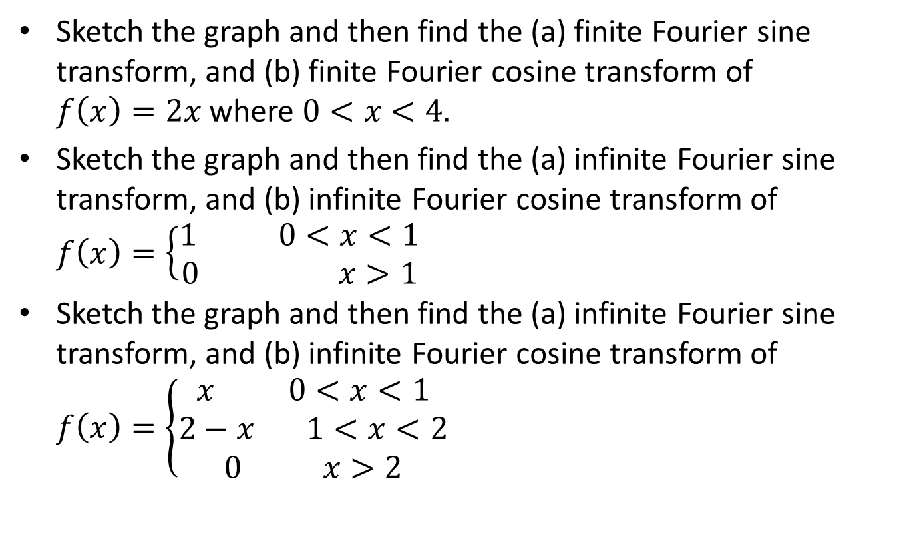
Sample Question
Sketch the graph and then find the (a) finite Fourier sine transform, and (b) finite Fourier cosine transform of $f\left(x\right)=2x$ where $0<x<4.$
Sketch the graph and then find the (a) infinite Fourier sine transform, and (b) infinite Fourier cosine transform of $f\left(x\right)=\left\{\begin{matrix}1 0<x<1 \\ 0 x>1\end{matrix}\right.$
Sketch the graph and then find the (a) infinite Fourier sine transform, and (b) infinite Fourier cosine transform of $f\left(x\right)=\left\{\begin{matrix}x 0<x<1 \\ 2−x 1<x<2 \\ 0 x>2\end{matrix}\right.$

Slide 9

Sample MCQ
Which Fourier transform formula needs to solve $f\left(x\right)=2x$ where $0<x<4?$
a) Finite formula b) infinite formula c) both d) none
Which Fourier transform formula needs to solve $f\left(x\right)=\left\{\begin{matrix}1 0<x<1 \\ 0 x>1\end{matrix}\right.$
a) Finite formula b) infinite formula c) both d) none

Slide 10
Outcome
After this lecture students
Will be able to calculate the finite Fourier sine and cosine transform.
Will be able to calculate the infinite Fourier sine and cosine transform.

Slide 11
Next class
Discussion about application of Fourier transform

